Slide 1
Web-scraping project – Rent the Runway
Yunrou Gong (Crystal)
August 14, 2016

Slide 2
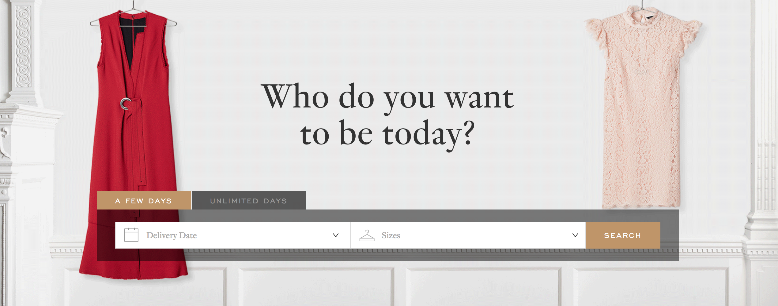
Analysis of Rent the Runway’s Dresses

Slide 3
Contents
1.Introduction & Background Review
2. Visualization the data
3. Modelling Approach
4. Accuracy &Validation
5. Limitation
6.Conclusion and Recommendation

Slide 4
What is their business model?
1. Background Review
What is rent the runway?
Two time options for customer to rent: 4- day or 8-day
back-up size at no additional cost to ensure fit
Additional cost for getting a second dress style with their order
Rental price is a fraction of retail price, include the dry cleaning and care of the garments
Return policy: pre-paid, pre-addressed package to return the dress
Online rental service for designer dress and accessory
purely e-commerce company
opened brick-and-mortar retail locations in New York City, Chicago, Washington, DC and Las Vegas.
Designer partners : Badgley Mischka, Vera Wang, Alexis Bittar, and Calvin Klein, etc.
4 million customers
Notes:
What is rent the runway?
Rent the Runway is an online service that provides designer dress and accessory rentals. Initially a purely e-commerce company, it later opened brick-and-mortar retail locations in New York City, Chicago, Washington, DC and Las Vegas.Rent the Runway now offers over thousands of dresses and accessories from over hundreds of designer partners, including Badgley Mischka, Vera Wang, Alexis Bittar, and Calvin Klein.
What is their business model?
Rent the Runway's 4 million customers can lease Rent the Runway’s designer dresses and accessories for a 4- or 8-day period for a fracton of the retail price. Rent the Runway carries apparel in sizes 0 to 22, depending on the designer. Each dress rental includes a back-up size at no additional cost to ensure fit. Customers can get a second dress style with their order for an additional cost. Rent the Runway provides customers with a pre-paid, pre-addressed package to return the dress, and offers insurance fee to protect against accidents. Rental prices include the dry cleaning and care of the garments.

Slide 5
Overview of the data
2072 observations (dresses)
13 variables (attributes)
Categorical variables:
item : Dresses Name
brand: Designer Name
type : Defined by cut/construction
img_url: the link to the image of the dress
Numerical variables:
reviews: Number of Reviews from customers
avgrating(0-10): Average Rating of the dress from 0 to 10 score
fit_large, true_to_size, fit_small : Number of customers voted for fitness
retailPrice: Retail price of the dress
rentalPrice_4: Rental price of the dress for 4 days duration
rentalPrice_8: Rental price of the dress for 8 days duration
discount(%): Percentage of decreasing of the dress for renting on retail price

Slide 6
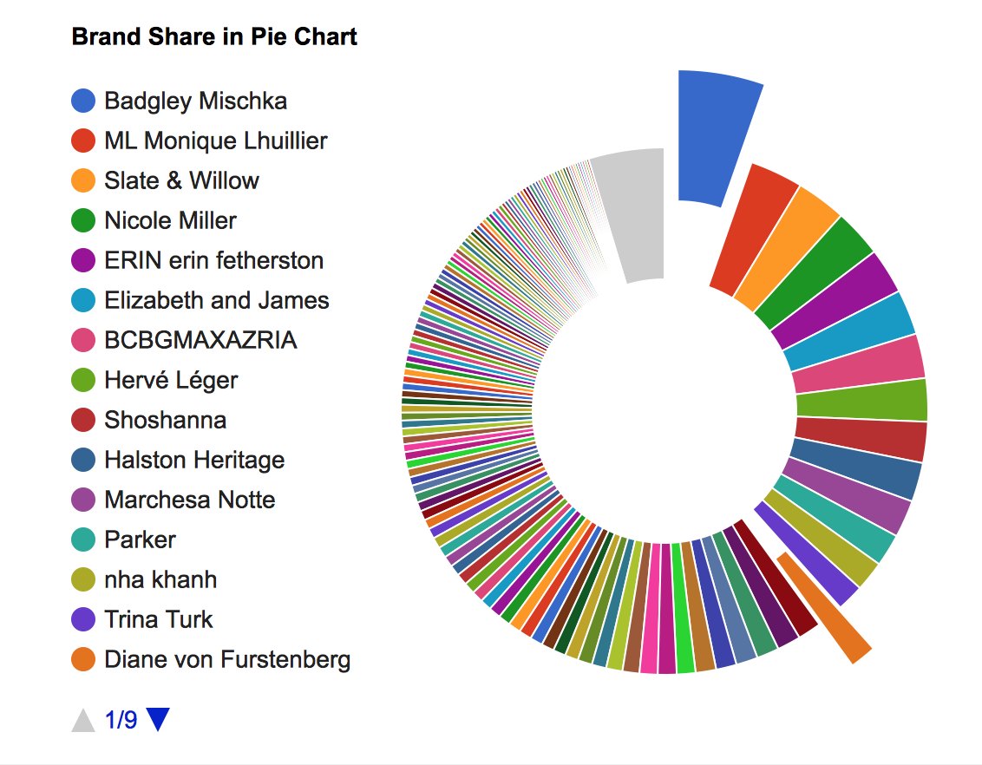
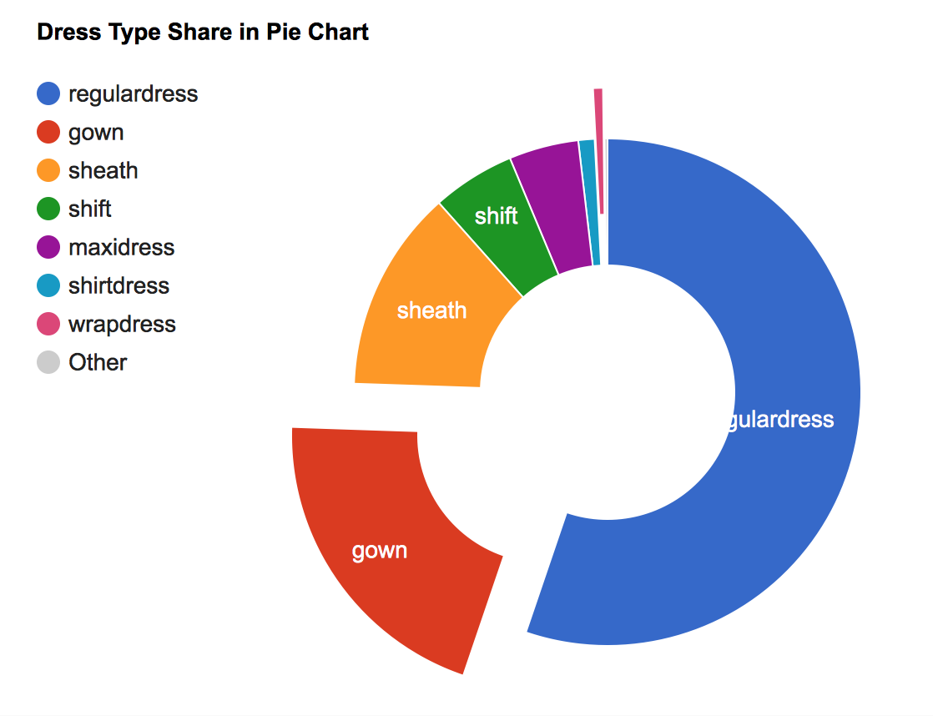
Visualization of the data by brand ,type
5%
9 Types
197 Brands
Notes:
badgley mischka-

Slide 7
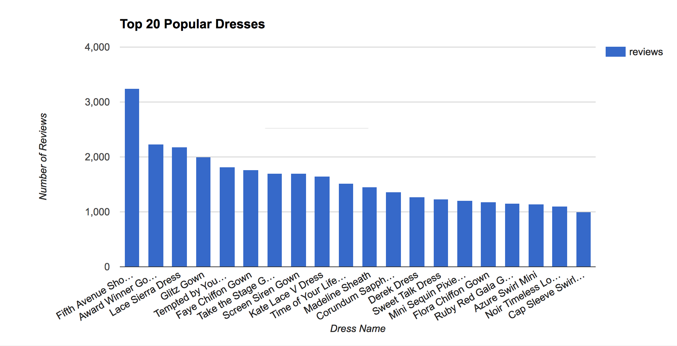
Popularity of the Dresses
Measurement : number of reviews , the more number of reviews a brand have , the more popular the it will be.
Notes:
Number of reviews treated as customer renting activity records , a random sample from the true population who rent the dresses .

Slide 8
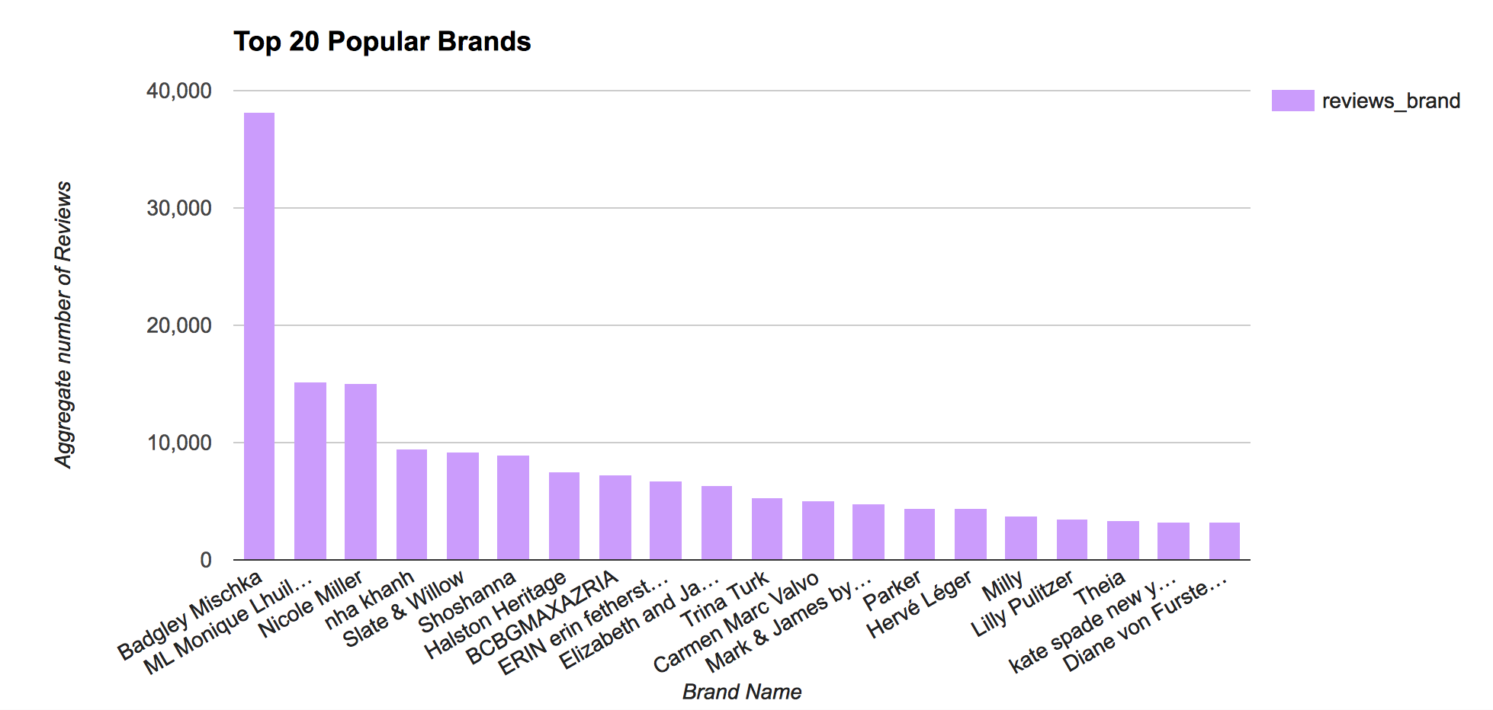
Popularity of the Brands

Slide 9
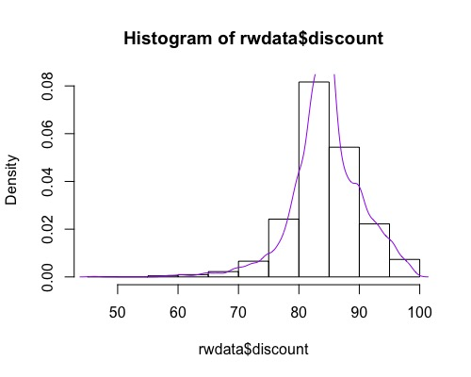
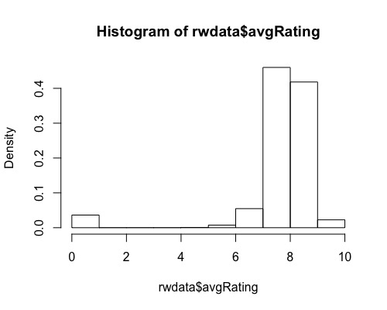
Exploratory Data Analysis

Slide 10
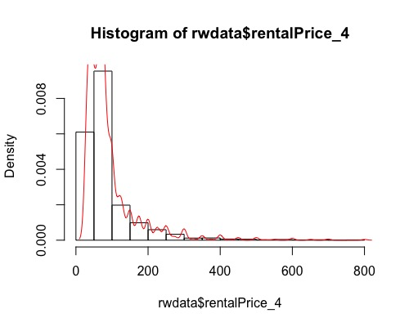
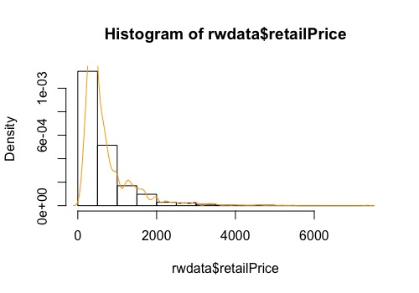
Exploratory Data Analysis

Slide 11
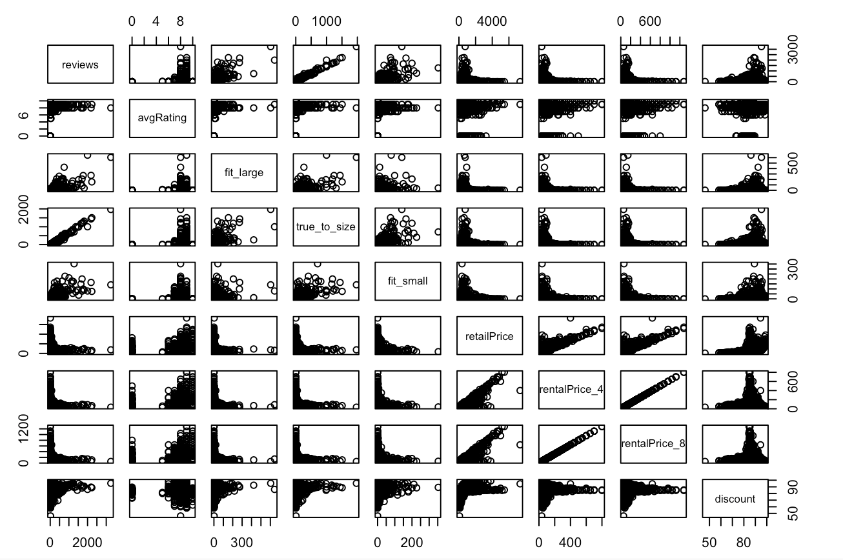
Exploratory Data Analysis

Slide 12
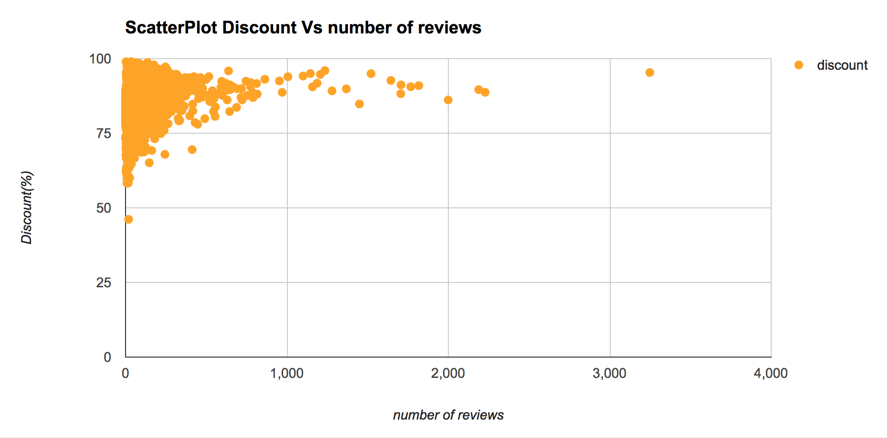
Exploratory Data Analysis

Slide 13
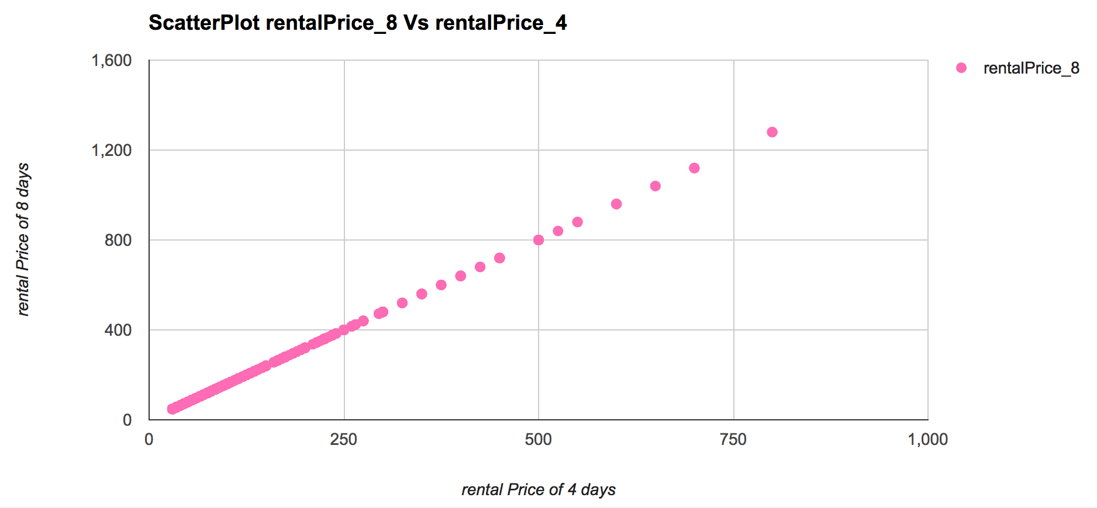
rentalPrice_8 = rentalPrice_4*(1+0.6)
Increase rate = 0.6

Slide 14
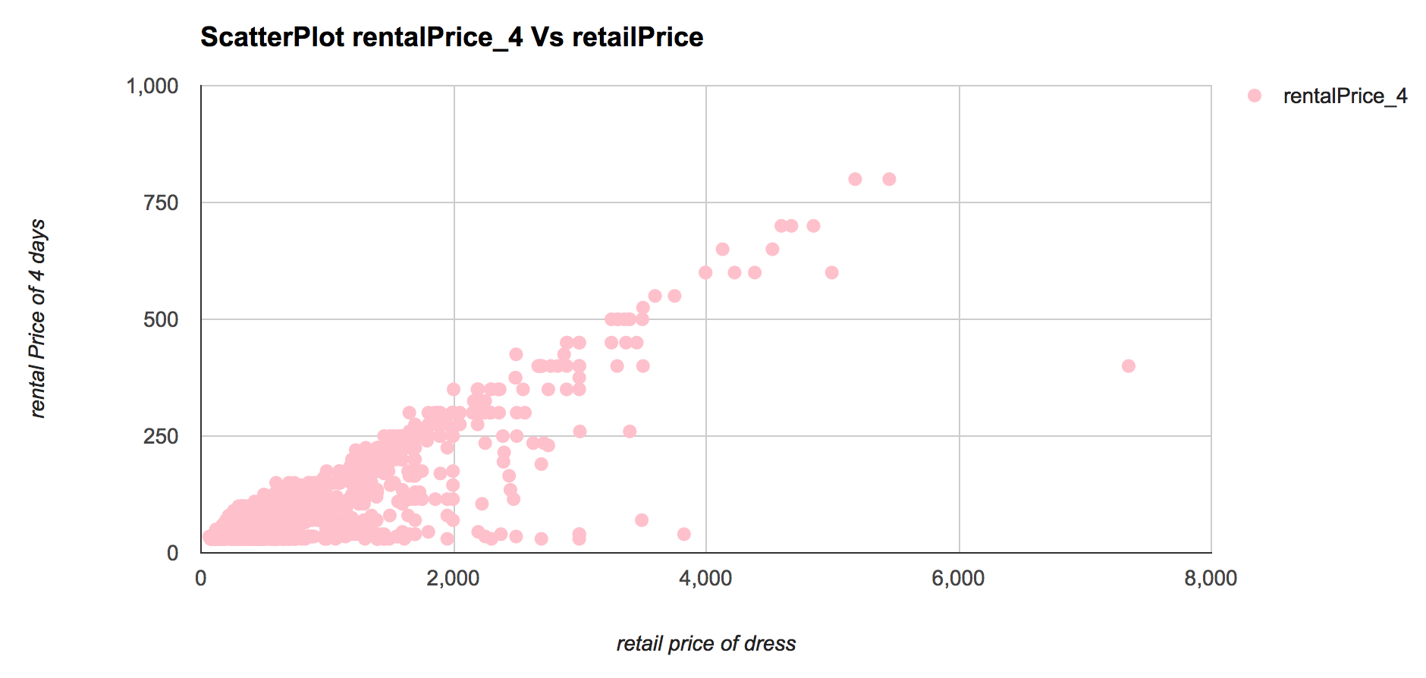
Exploratory Data Analysis

Slide 15
3. Predicative Modelling Approach- Linear Regression
Response Variable | Predictive Variable
rentalPrice_4 | retailPrice, brand , type
Outlier:
item brand type rentalPrice_4 retail Price
2325 Faux Shirt Dress Jason Wu shirtdress 400 7345

Slide 16
Variable Selection for the Linear Model
Model | Predictive Variable | df | AIC | BIC | Adjusted R Square
Model 1 | retailPrice + brand + type | 207 | 18956.11 | 20106.73 | 0.8417
Model 2 | retailPrice + type | 11 | 19649.46 | 19710.61 | 0.7498
Model 3 | retailPrice + brand | 199 | 19058.35 | 20164.50 | 0.8324
Model 4 | retailPrice | 3 | 19703.75 | 19720.42 | 0.7416(*)
Notes:
The adjusted R^2 is 0.7498, meaning that approximately 75%of the variation
In rental price of 4 days is accounted for by the variables in our model.

Slide 17
4.Accuracy & Validation
rentalPrice_4= 19.19418 + 0.10829* retailPrice + 11.89650 *gown + 11.15222 * maxidress+ 11.15222*regulardress+(-11.01769)*sheath +(-4.54707)*shift +(-13.07648) *shirtdress + 20.88506*slipdress+4.59122 * wrapdress
Test set
(30%)
Build model
Training set
(70%)
Measure performance
1374.112
(MSE)
Notes:
#
#When all variables are 0 and the price on the frock type, the
#average expected rental price of 4 days is about $19.19
#As the retail Price for address increases by one
#point, the rental price increases on average by about 11 penny WHILE HOLDING ALL OTHER
#VARIABLES CONSTANT.
#A gown dress has an average rental price that is about $12
#more expensive than a frock dress WHILE HOLDING ALL OTHER VARIABLES CONSTANT.
#a maxi dress has an average rental price that is about $11 more expensive than frock dress, WHILE HOLDING ALL OTHER VARIABLES CONSTANT
#a regular dress has an $11 more expensive than frock type dress, WHILE HOLDING ALL OTHER VARIABLES CONSTANT
# a sheath dress has an $11 cheaper than frock type dress , WHILE HOLDING ALL OTHER VARIABLES CONSTANT
# a shift dress has an $5 cheaper than frock type dress, WHILE HOLDING ALL OTHER VARIABLES CONSTANT
# a shirt dress has an $13 more expensive than frock type dress, WHILE HOLDING ALL OTHER VARIABLES CONSTANT
# a slip dress has an $20 more expensive than frock type dress, WHILE HOLDING ALL OTHER VARIABLES CONSTANT
# a wrap dress has an $5 more expensive than frock type dress, WHILE HOLDING ALL OTHER VARIABLES CONSTANT

Slide 18
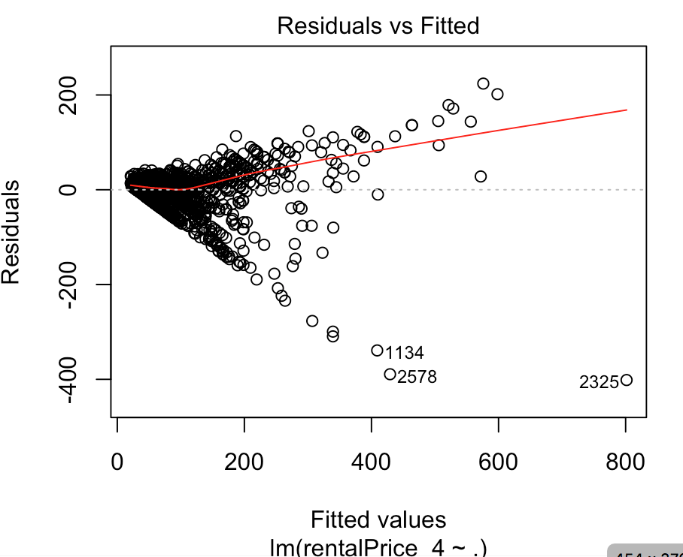
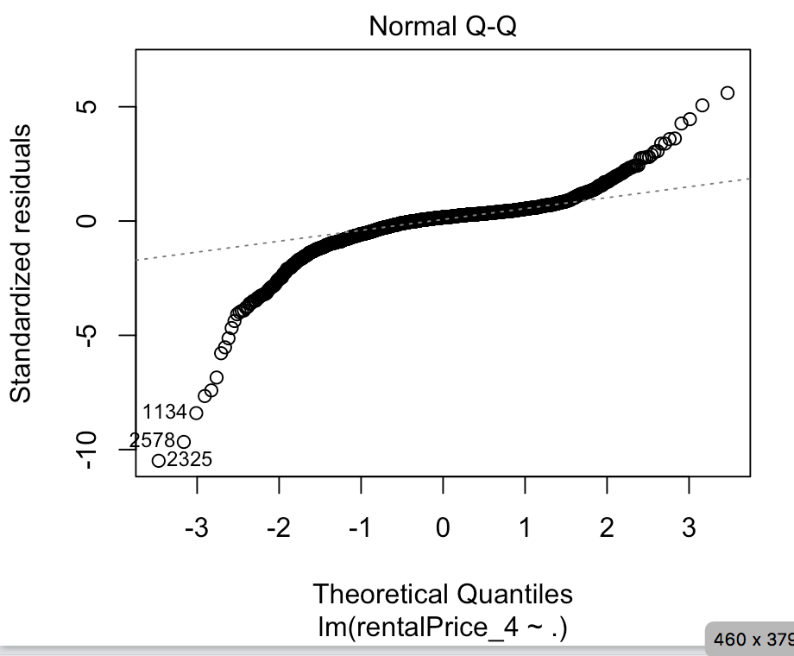
5. Limitation

Slide 19
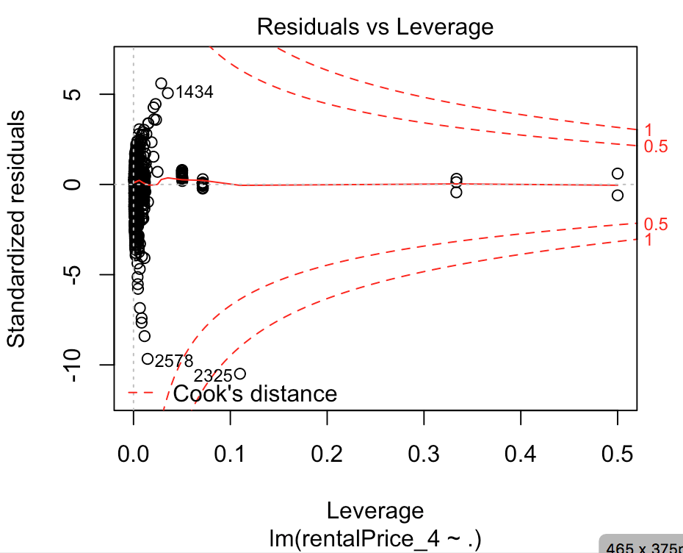
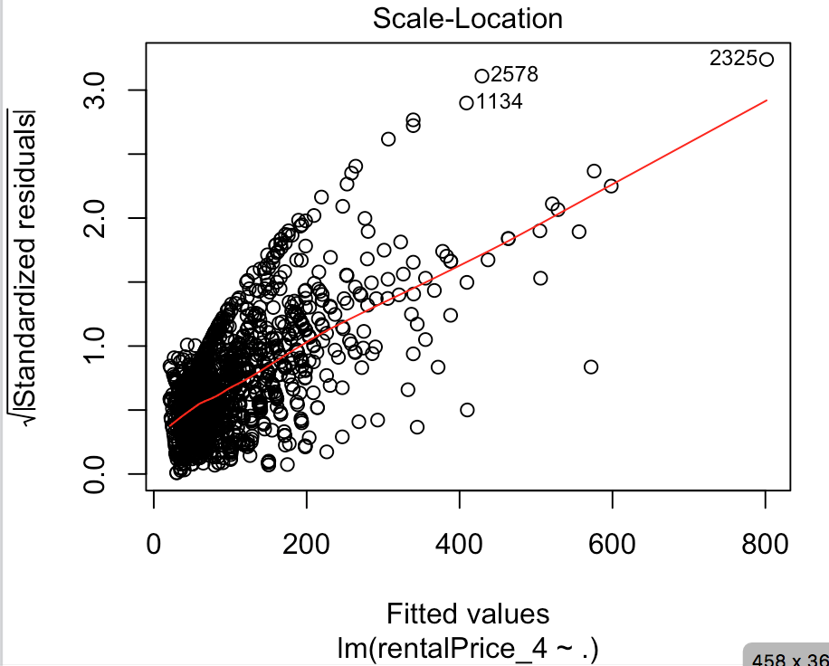
5. Limitation

Slide 20
5.Conclusions and Recommendation
Key findings
Positive correlation between rentalPrice _4 and retail price of dress
Recommendation
Use other predictive modelling approaches (regression decision tree) to compare the model accuracy and validation
Rental price of 8 days duration is increased by 60% of rental Price of 4 days
Number of Reviews is not obvious correlated with discount rate, means customer behaviour has little to do with bargaining power
Could conduct sentimental analysis on the review details and could build a recommendation system based on each reviewers’ information

Slide 21

Questions and Answers

